Slide 1
Getting our sample data

Slide 2
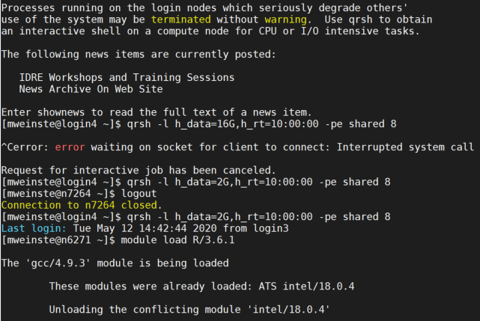
Getting Started

Slide 3
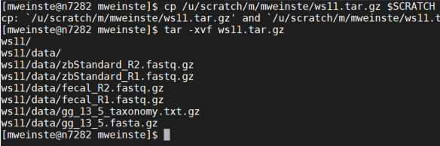
Getting a Started

Slide 4
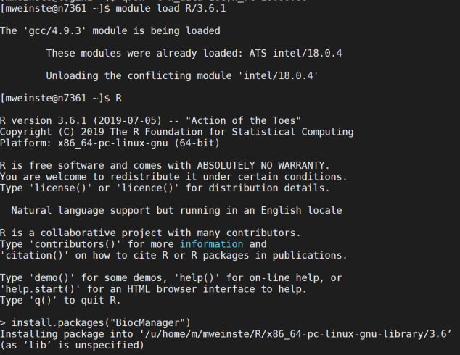
Install BioConductor
Answer “yes” to questions about installation location if asked

Slide 5
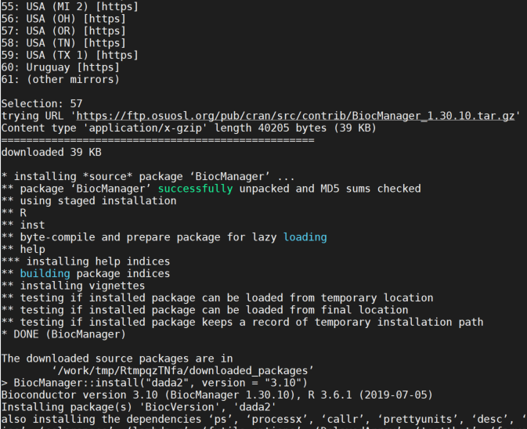
Install DADA2

Slide 6
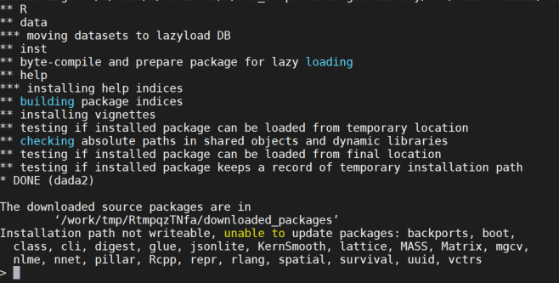
…it’s gonna take a while

Slide 7

Set “path” to Where the Sequences Are
Use your own scratch folder here

Slide 8
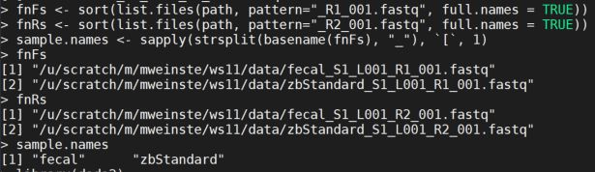
Have R Find and Sort Your Sequencing Files

Slide 9
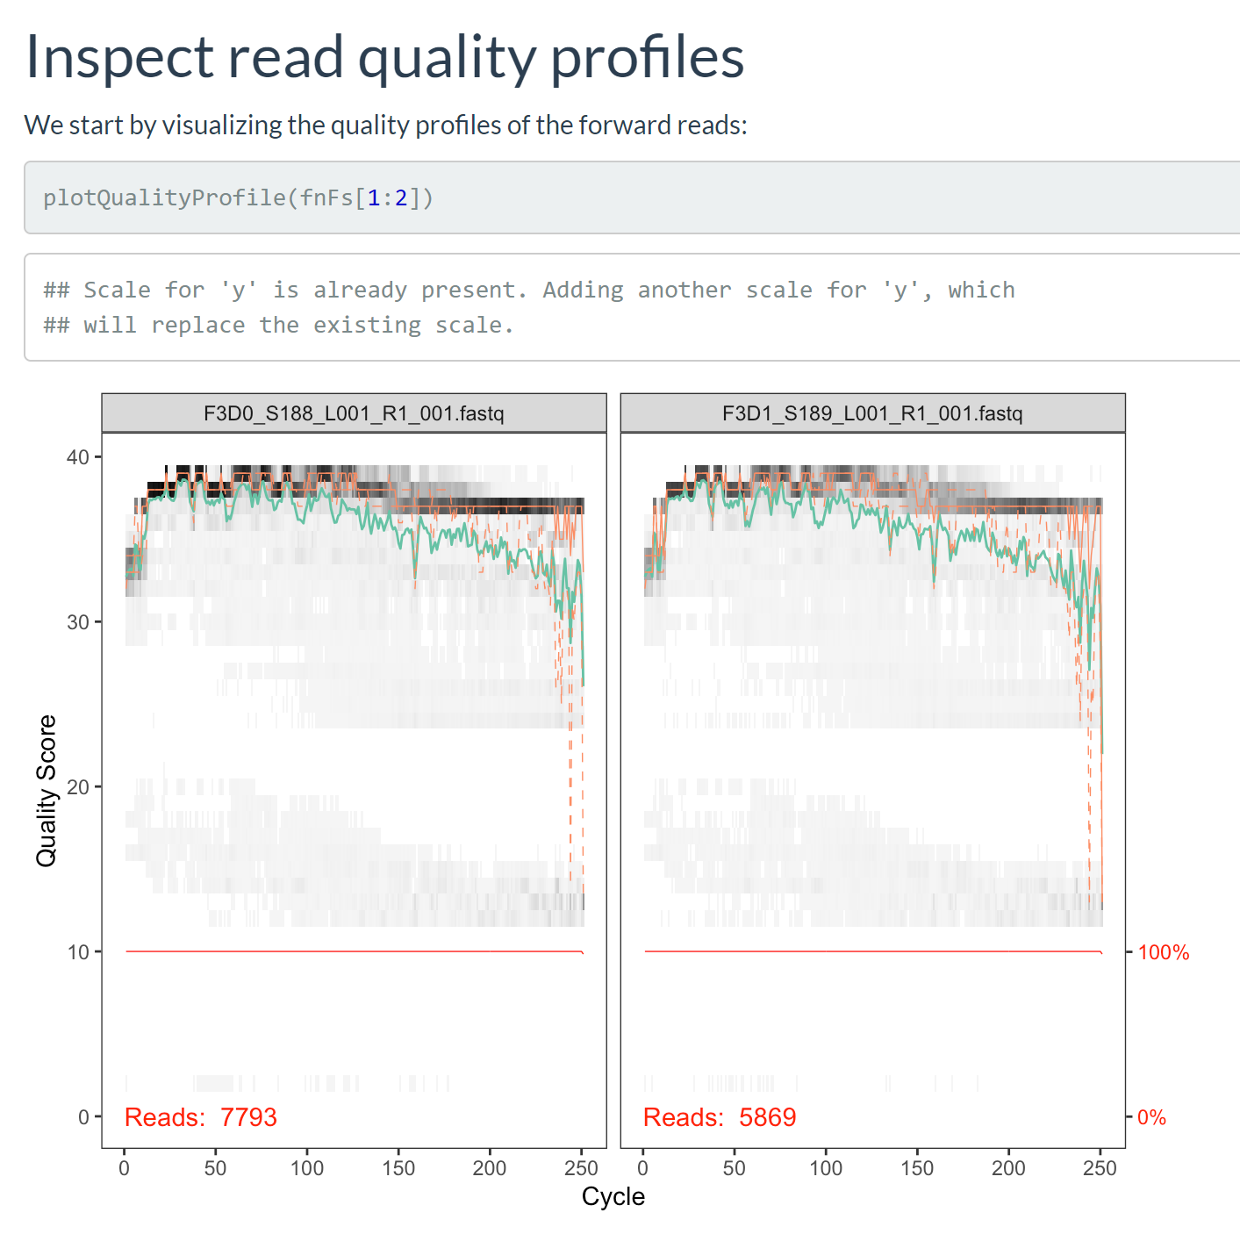
The “Official” Method

Slide 10
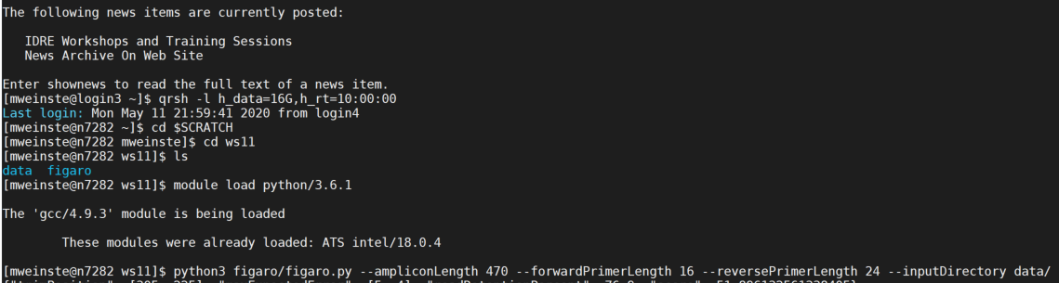
Open a New Terminal Tab/Window
Amplicon length and primer lengths will be determined by your method of library prep and target region

Slide 11
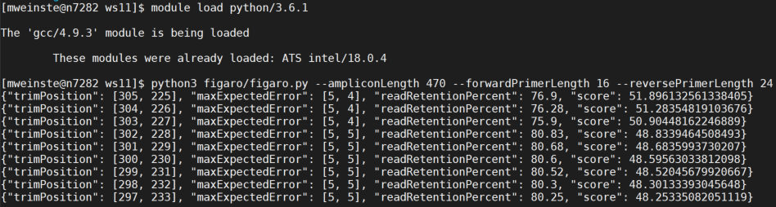
Open a New Terminal Tab/Window
You may have to scroll back up a bit to find the first set of values.

Slide 12
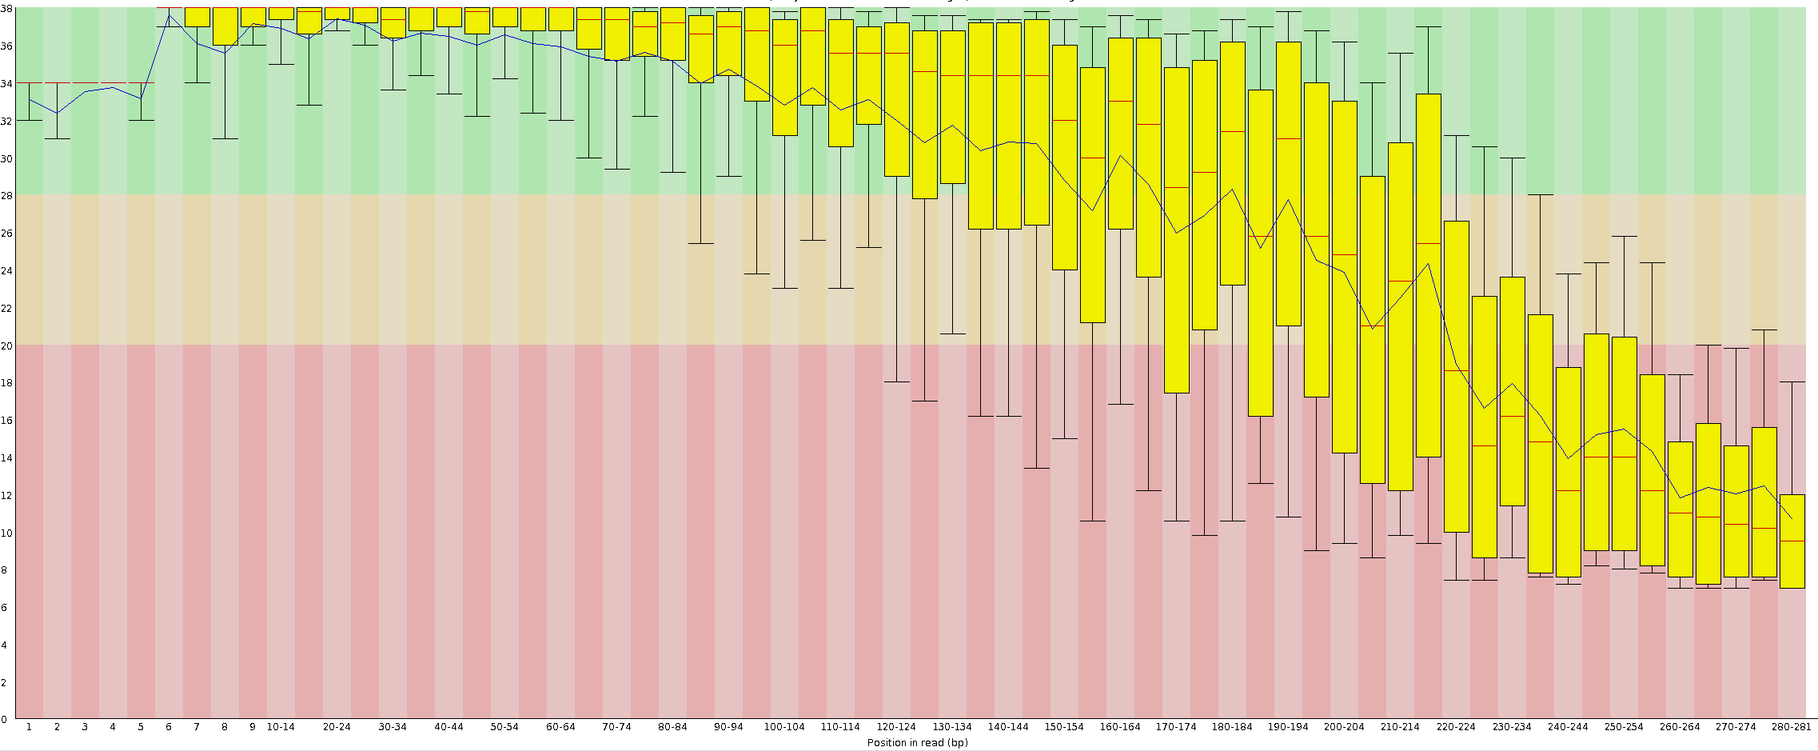
Selecting Read Trimming Parameters

Slide 13
Selecting Read Trimming Parameters
0
100
200
300
400
500
600
700
800
900
1000
1100
1200
1300
1400
1500 bp
V1
V2
V3
V4
V5
V6
V7
V8
V9
The Goal

Slide 14
Selecting Read Trimming Parameters
0
100
300
400
500
600
700
800
900
1000
1100
1200
1300
1400
1500 bp
V1
V2
V3
V4
V5
V6
V7
V8
V9

Slide 15
Selecting Read Trimming Parameters
0
100
300
400
500
600
700
800
900
1000
1100
1200
1300
1400
1500 bp
V1
V2
V3
V4
V5
V6
V7
V8
V9

Slide 16
The Challenge
There is some flexibility in where the overlap happens.
Most pipelines have a technician look at the quality plots and select trimming points.
How do we minimize or remove human interaction in trimming parameter selection?

Slide 17
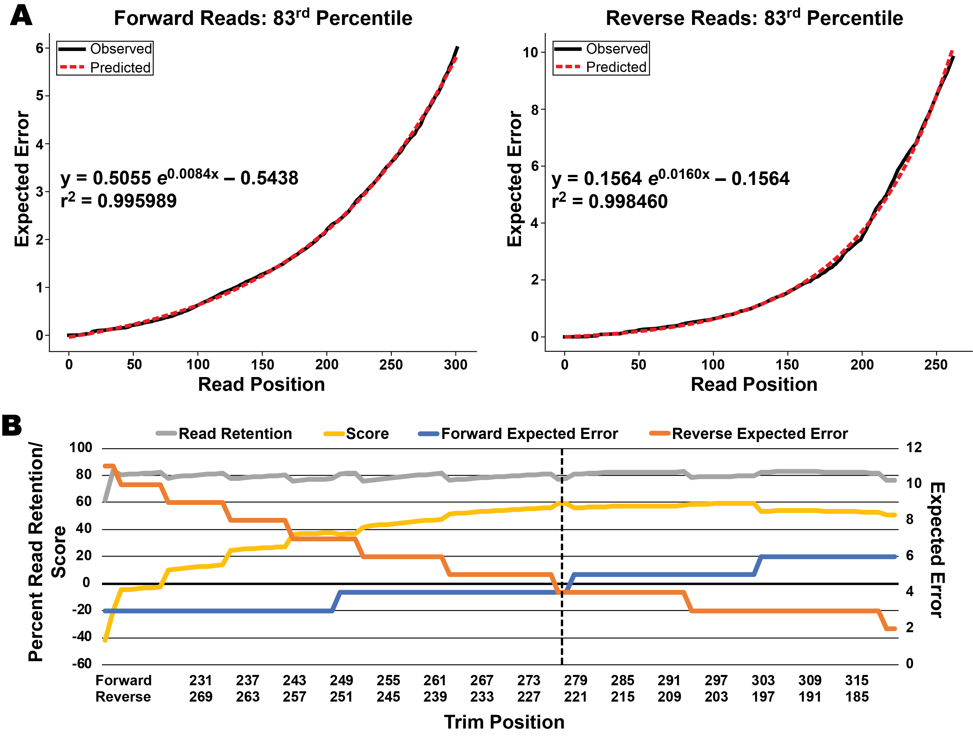
Model Expected Error Accumulation

Slide 18
Find An Optimal Trimming Site

Slide 19
Return to Your Terminal Running R

Slide 20

Prepare To Run FilterAndTrim
This may tell you it is loading other packages (such as Rcpp). This is NOT a problem.

Slide 21
Trim and Filter
out <- filterAndTrim(fnFs, filtFs, fnRs, filtRs, truncLen=c(305,225), trimLeft=c(16,24), maxN=0, maxEE=c(5,4), truncQ=2, rm.phix=TRUE, compress=TRUE, multithread=TRUE)

Slide 22

Learn Forward and Reverse Errors

Slide 23
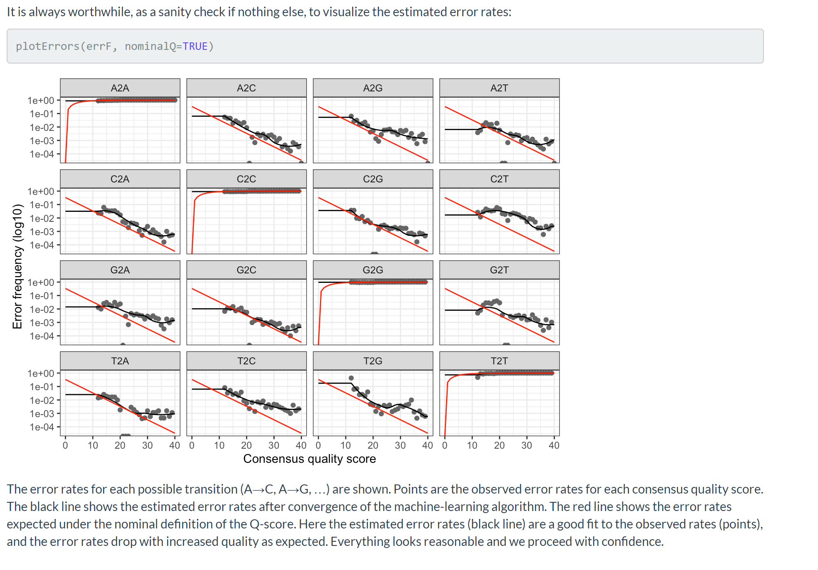
Visualizing the Error Models

Slide 24
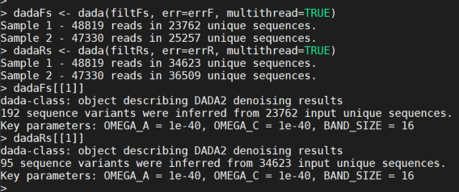
Apply the Denoising

Slide 25
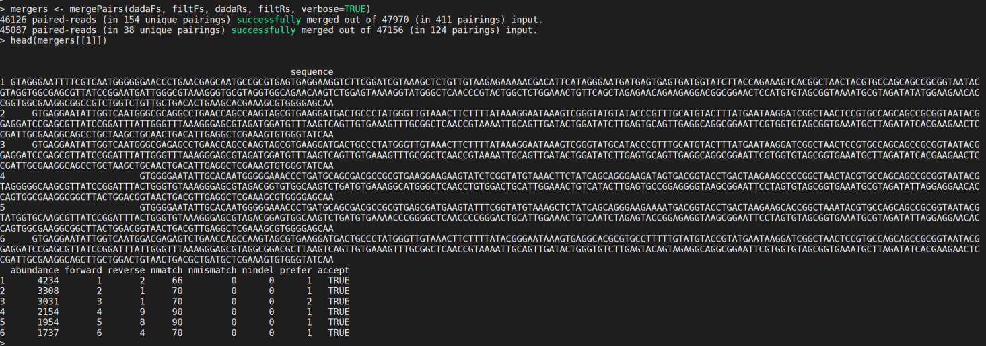
Attempt to Merge Read Pairs

Slide 26
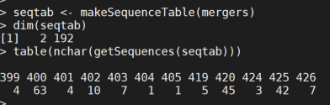
Inspect Our Denoised Amplicons

Slide 27
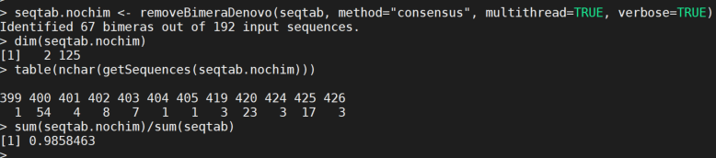
Remove Chimeras and Examine Effect

Slide 28
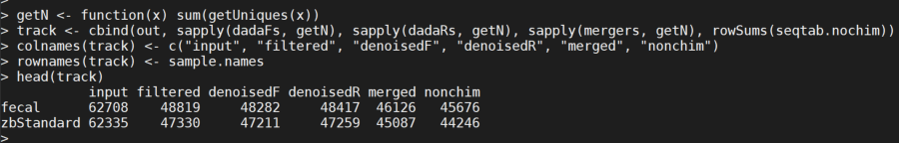
Track Our Reads

Slide 29
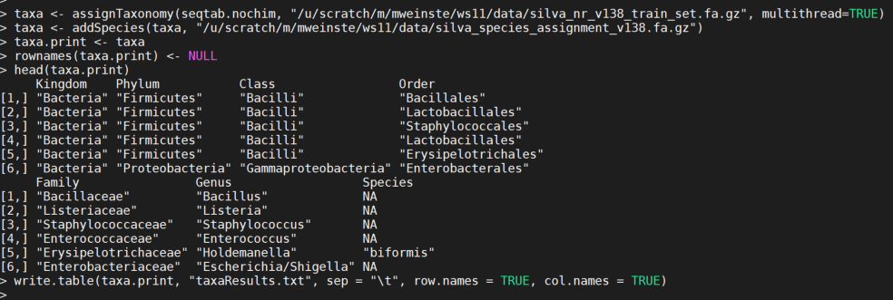
Assign Taxa
Taxa table is now in your ws11 folder

